Slide 1
Session 9
Customizing Colour bars
Multiple Subplots
Text and Annotation
Customizing Ticks

Slide 2
Bar Plot
It is used to compare numerical data over some categories/groups.
It can be the case that we need to compare Marks and Attendance(numerical) together across Subjects. Hence grouped bar plots can be used.

Slide 3
Why use Bar Plot?
The multiple numerical data columns can be compared against groups.

Slide 4
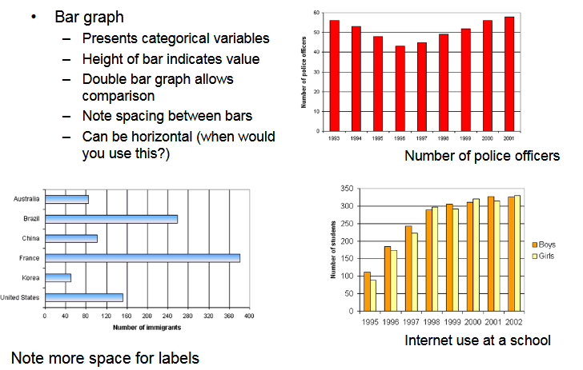
Types of Bar Plot

Slide 5
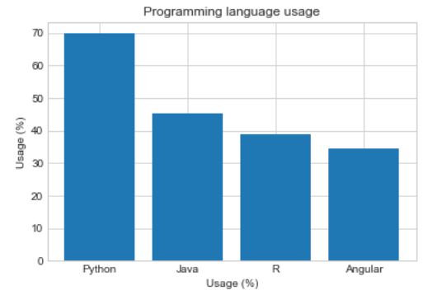
Example of Bar Plot
labels = ["Python", "Java", "R", "Angular"]
usage = [69.8, 45.3, 38.8, 34.4]
y_positions = range(len(labels))
plt.bar(y_positions, usage)
plt.xticks(y_positions, labels)
plt.ylabel("Usage (%)")
plt.xlabel("Usage (%)")
plt.title("Programming language usage")
plt.show()

Slide 6
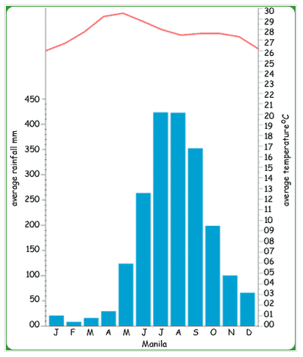
Real life example of Bar Plot
Bar Plot for Weather forecast

Slide 7
Comparison of Bar Plot and Histogram
Bar Plot | Histogram Plot
Bar graph is a pictorial representation of data that uses bars to compare different categories of data | Histogram refers to a graphical representation, that displays data by way of bars to show the frequency of numerical data.
Comparison of discrete variables | Distribution of non-discrete variables
Categorical data | Quantitative data
Bars do not touch each other, hence there are spaces between bars. | Bars touch each other, hence there are no spaces between bars
Elements are taken as individual entities. | Elements are grouped together, so that they are considered as ranges.

Slide 8
Box Plot
It provides a lot of information about any numerical data column.
It is also known as box-and-whisker plot.
Minimum, first quartile, median, third quartile, and maximum are extracted from the plots.
The median is the value that separates the higher half of a data from the lower half.

Slide 9
Box Plot
The first quartile is the median of the data values to the left of the median in our ordered values.
For example, if we have the numbers 1, 3, 4, 7, 8, 8, 9, the first quartile is the median from the 1, 3, 4 values, so it’s 3.
The third quartile is the median of the data values to the right of the median in our ordered values.
For example, if we use these numbers 1, 3, 4, 7, 8, 8, 9 again, the third quartile is the median from the 8, 8, 9 values, so it’s 8.

Slide 10
Why use Box Plot?
The main purpose is to give an idea of the distribution of the data.
This type of plot can also show outliers. An outlier is a data value that lies outside the overall pattern.
They are visualized as circles. When we have outliers, the minimum and the maximum are visualized as the min and the max values from the value
When we need a summary of the Histogram, we will be using the Box Whisker plot.

Slide 11
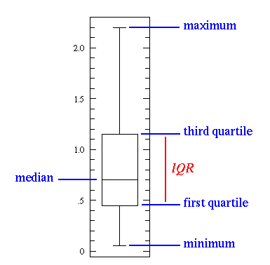
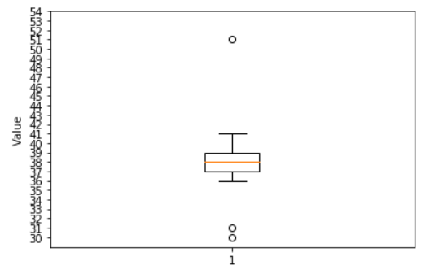
Example of Box Plot
values = [30, 31, 36, 37, 37, 38, 38, 39, 39, 39, 40, 41, 51]
plt.boxplot(values)
plt.yticks(range(30, 55))
plt.ylabel("Value")
plt.show()

Slide 12
Multiple Subplots
Compare different views of data side by side.
Groups of smaller axes that can exist together within a single figure.
The function subplot create a figure and a set of subplots.
It is a wrapper function to make it convenient to create common layouts of subplots, including the enclosing figure object, in a single call.

Slide 13
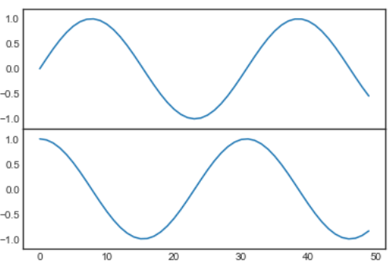
Example of Multiple Subplot
import matplotlib.pyplot as plt
plt.style.use('seaborn-white')
import numpy as np
fig = plt.figure()
ax1 = fig.add_axes([0.1, 0.5, 0.8, 0.4],
xticklabels=[], ylim=(-1.2, 1.2))
ax2 = fig.add_axes([0.1, 0.1, 0.8, 0.4],
ylim=(-1.2, 1.2))
x = np.linspace(0, 10)
ax1.plot(np.sin(x))
ax2.plot(np.cos(x));

Slide 14
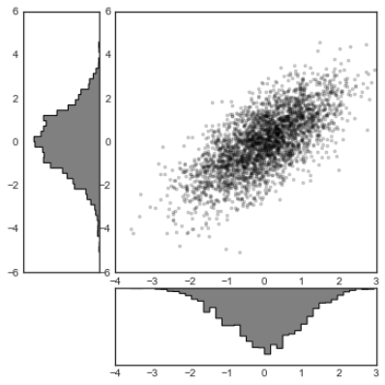
Example of Histogram Subplot
mean = [0, 0]
cov = [[1, 1], [1, 2]]
x, y = np.random.multivariate_normal(mean, cov, 3000).T
# Set up the axes with gridspec
fig = plt.figure(figsize=(6, 6))
grid = plt.GridSpec(4, 4, hspace=0.2, wspace=0.2)
main_ax = fig.add_subplot(grid[:-1, 1:])
y_hist = fig.add_subplot(grid[:-1, 0], xticklabels=[], sharey=main_ax)
x_hist = fig.add_subplot(grid[-1, 1:], yticklabels=[], sharex=main_ax)
# scatter points on the main axes
main_ax.plot(x, y, 'ok', markersize=3, alpha=0.2)
# histogram on the attached axes
x_hist.hist(x, 40, histtype='stepfilled',
orientation='vertical', color='gray')
x_hist.invert_yaxis()
y_hist.hist(y, 40, histtype='stepfilled',
orientation='horizontal', color='gray')
y_hist.invert_xaxis()

Slide 15
Text and Annotation
Most basic types of annotations we will use are axes labels and titles
A text attribute, and can be displayed with or without markers.
Standalone text annotations can be added to figures using fig.add_annotation()
With or without arrows, and they can be positioned absolutely within the figure, or they can be positioned relative to the axes of 2d or 3d cartesian subplots i.e. in data coordinates.
Text annotations can be positioned absolutely or relative to data coordinates in 2d/3d cartesian subplots only.

Slide 16
Why use Text and Annotation
Creating a good visualization
Small textual cues and labels are necessary.
How we might visualize and annotate it to help convey interesting information.

Slide 17
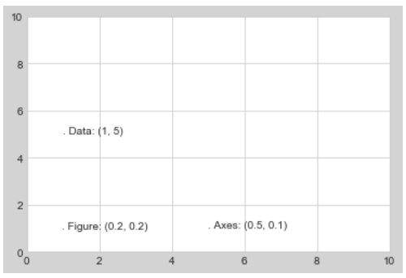
Text Transformation
fig, ax = plt.subplots(facecolor='lightgray')
ax.axis([0, 10, 0, 10])
# transform=ax.transData is the default, but we'll specify it anyway
ax.text(1, 5, ". Data: (1, 5)", transform=ax.transData)
ax.text(0.5, 0.1, ". Axes: (0.5, 0.1)", transform=ax.transAxes)
ax.text(0.2, 0.2, ". Figure: (0.2, 0.2)", transform=fig.transFigure);

Slide 18
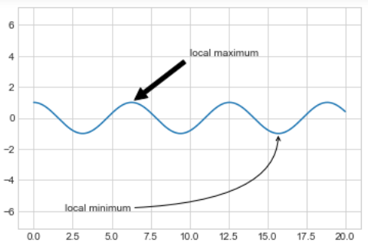
Arrows and Annotation
%matplotlib inline
fig, ax = plt.subplots()
x = np.linspace(0, 20, 1000)
ax.plot(x, np.cos(x))
ax.axis('equal')
ax.annotate('local maximum', xy=(6.28, 1), xytext=(10, 4),
arrowprops=dict(facecolor='black', shrink=0.05))
ax.annotate('local minimum', xy=(5 * np.pi, -1), xytext=(2, -6),
arrowprops=dict(arrowstyle="->",
connectionstyle="angle3,angleA=0,angleB=-90"));

Slide 19
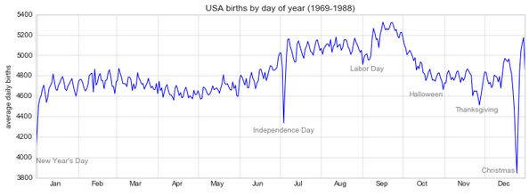
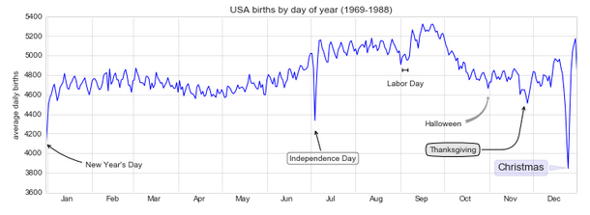
Example of Text Alignment

Slide 20
Color Customizing
Color can be different for different chart
A color bar is a separate axes that can provide a key for the meaning of colors in a plot.
The colormap can be specified using the cmap argument to the plotting function

Slide 21
Category of Colormap
Sequential colormaps: These are made up of one continuous sequence of colors (e.g., binary or viridis).
Divergent colormaps: These usually contain two distinct colors, which show positive and negative deviations from a mean (e.g., RdBu or PuOr).
Qualitative colormaps: these mix colors with no particular sequence (e.g., rainbow or jet).

Slide 22
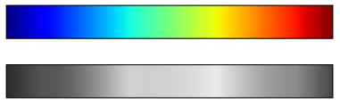
Jet Colormap
view_colormap('jet')
Default in Matplotlib prior to version 2.0,
Example of a qualitative colormap.
def view_colormap(cmap):
"""Plot a colormap with its grayscale equivalent""“
cmap = plt.cm.get_cmap(cmap)
colors = cmap(np.arange(cmap.N))
cmap = grayscale_cmap(cmap)
grayscale = cmap(np.arange(cmap.N))
fig, ax = plt.subplots(2, figsize=(6, 2), subplot_kw=dict(xticks=[], yticks=[])) ax[0].imshow([colors], extent=[0, 10, 0, 1]) ax[1].imshow([grayscale], extent=[0, 10, 0, 1])

Slide 23
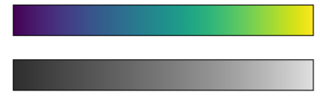
Viridis Colormap
Bright stripes in the grayscale image.
Even in full color, this uneven brightness means that the eye will be drawn to certain portions of the color range, which will potentially emphasize unimportant parts of the dataset.
It's better to use a colormap such as viridis (the default as of Matplotlib 2.0),
Specifically constructed to have an even brightness variation across the range.
view_colormap('viridis')

Slide 24
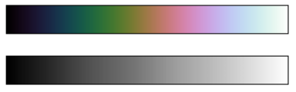
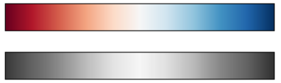
Cubehelix and RdBu Colormap
Rainbow schemes, another good option for continuous data is the cubehelix colormap
Showing positive and negative deviations from some mean, dual-color colorbars such as RdBu (Red-Blue) can be useful.
Positive-negative information will be lost upon translation to grayscale!
view_colormap('cubehelix')
view_colormap('RdBu')

Slide 25
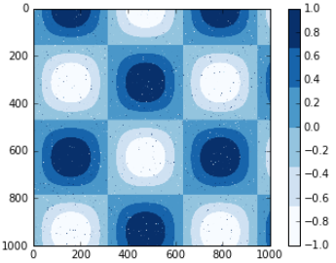
Discrete Colorbars
Colormaps are by default continuous, but sometimes you'd like to represent discrete values.
Use the plt.cm.get_cmap() function, and pass the name of a suitable colormap along with the number of desired bins:
plt.imshow(I, cmap=plt.cm.get_cmap('Blues', 6))
plt.colorbar()
plt.clim(-1, 1);

Slide 26
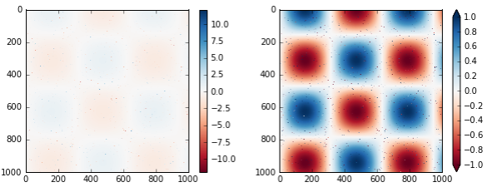
Color Limits and Extension
The colorbar itself is simply an instance of plt.Axes, so all of the axes and tick formatting tricks we've learned are applicable.
We can narrow the color limits and indicate the out-of-bounds values with a triangular arrow at the top and bottom by setting the extend property.
# make noise in 1% of the image pixels speckles = (np.random.random(I.shape) < 0.01) I[speckles] = np.random.normal(0, 3, np.count_nonzero(speckles)) plt.figure(figsize=(10, 3.5)) plt.subplot(1, 2, 1) plt.imshow(I, cmap='RdBu') plt.colorbar() plt.subplot(1, 2, 2) plt.imshow(I, cmap='RdBu') plt.colorbar(extend='both') plt.clim(-1, 1);

